Slide 1
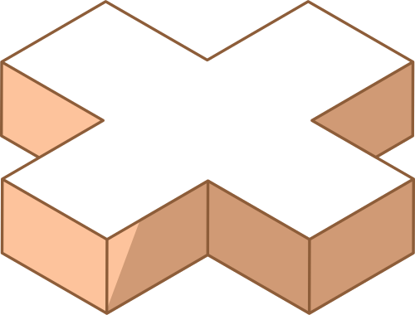
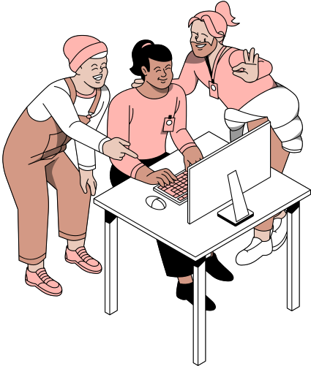
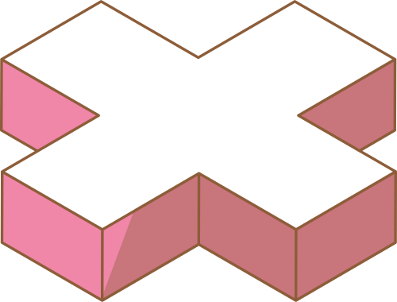
SELF-ESTEEM & INTERPERSONAL RELATIONSHIP
GROUP 4: CHAPTER 4-A

Slide 2
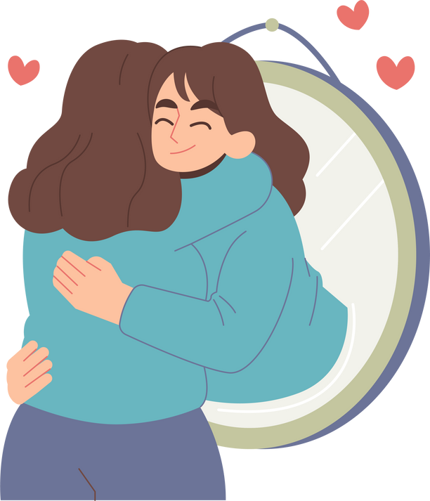
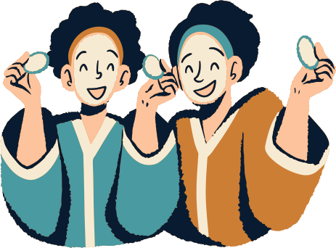

WHAT IS SELF-ESTEEM
Self-esteem refers to a person’s overall sense of his or her value or worth. It can be considered a sort of measure of how much a person “values, approves of, appreciates, prizes, or likes him or herself” (Adler & Stewart, 2004).
According to self-esteem expert Morris Rosenberg, self-esteem is quite simply one’s attitude toward oneself (1965). He described it as a “favourable or unfavourable attitude toward the self”.

Slide 3
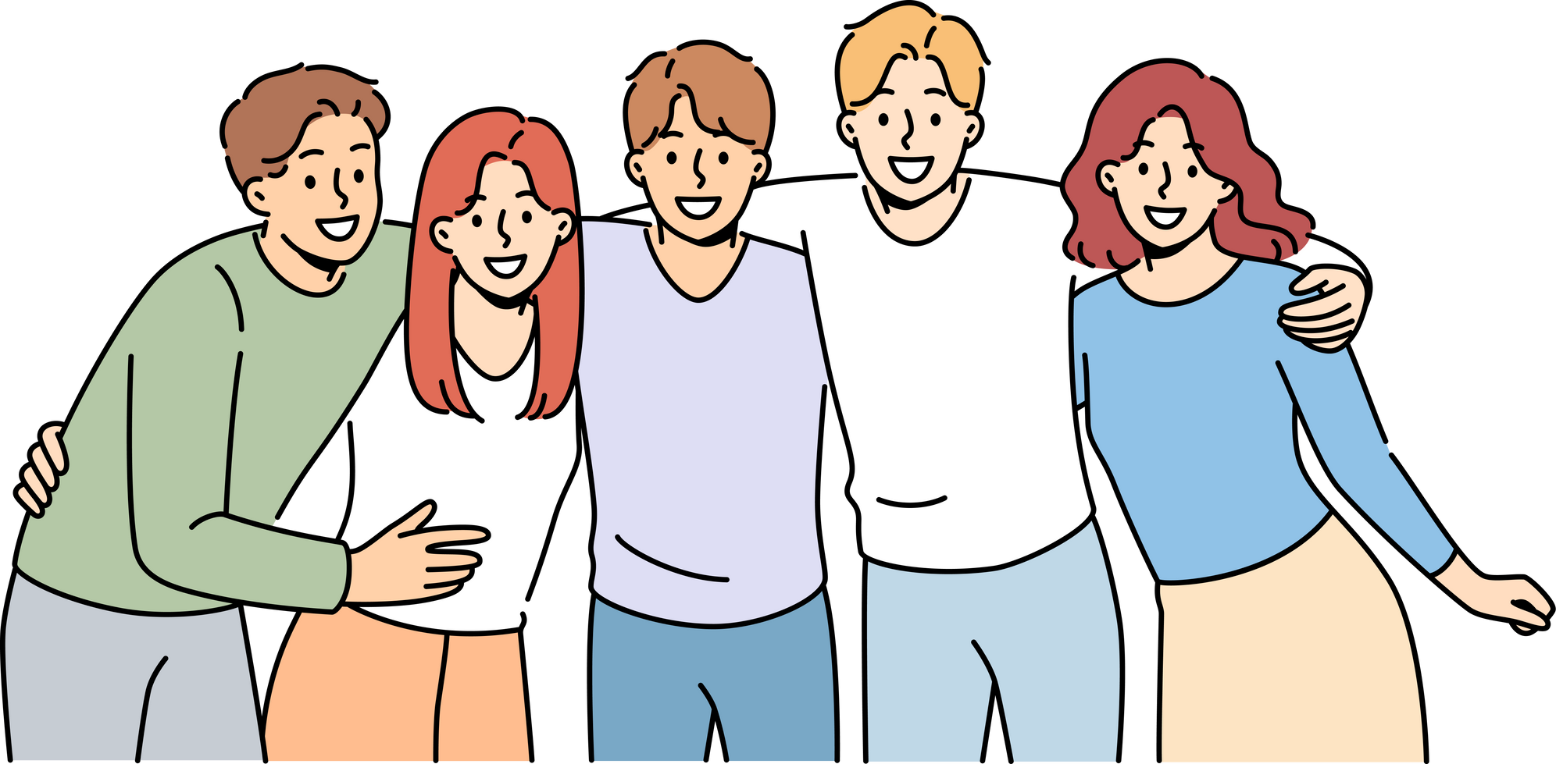
INTERPERSONAL RELATIONSHIP
A strong bond between two or more people refers to interpersonal relationship. Attraction between individuals brings them close to each other and eventually results in a strong interpersonal relationship.
Develops and maintains effective relationships with others; relates well to people from varied backgrounds and in different situations; shows understanding, courtesy, tact, empathy, concern, and politeness.

Slide 4
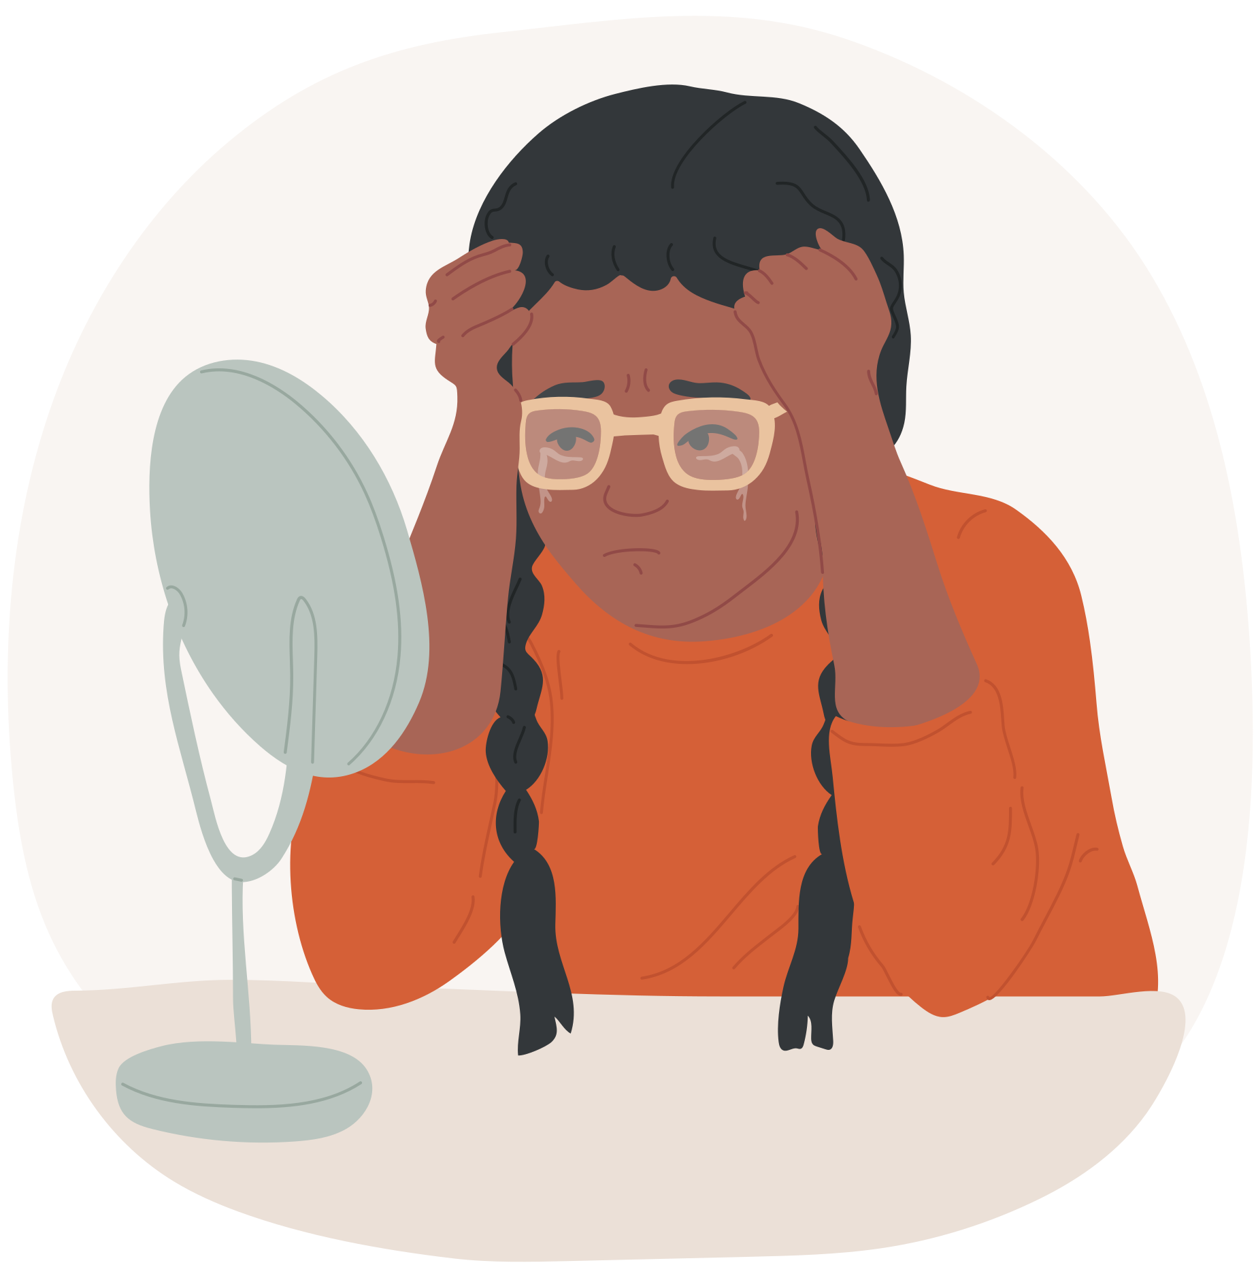
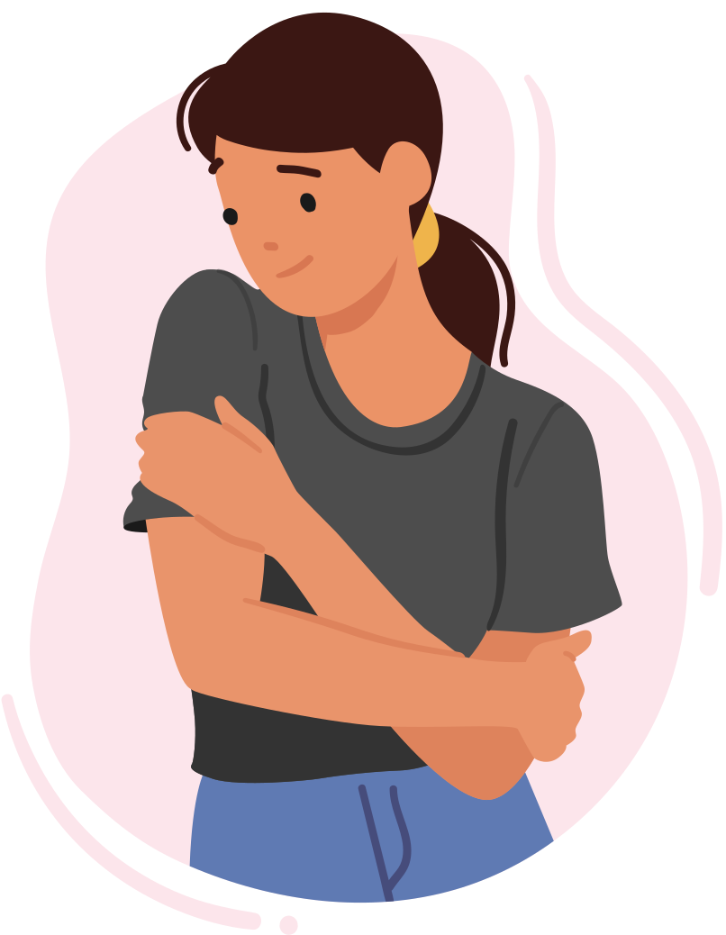
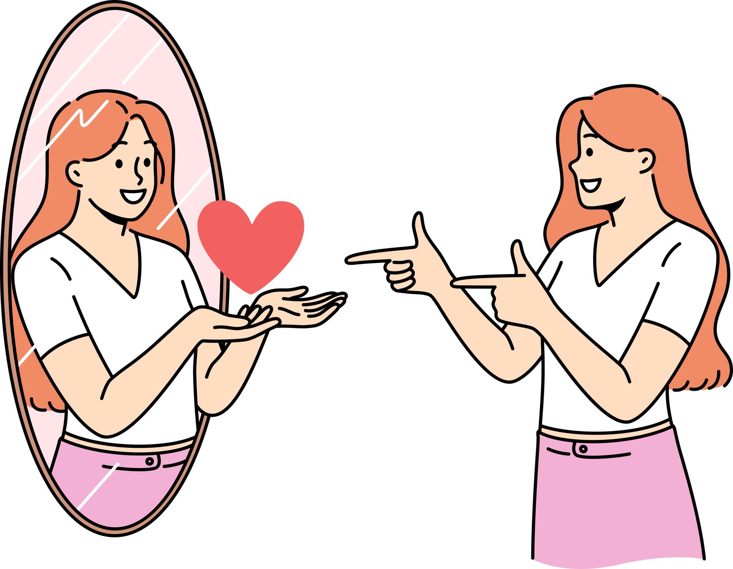
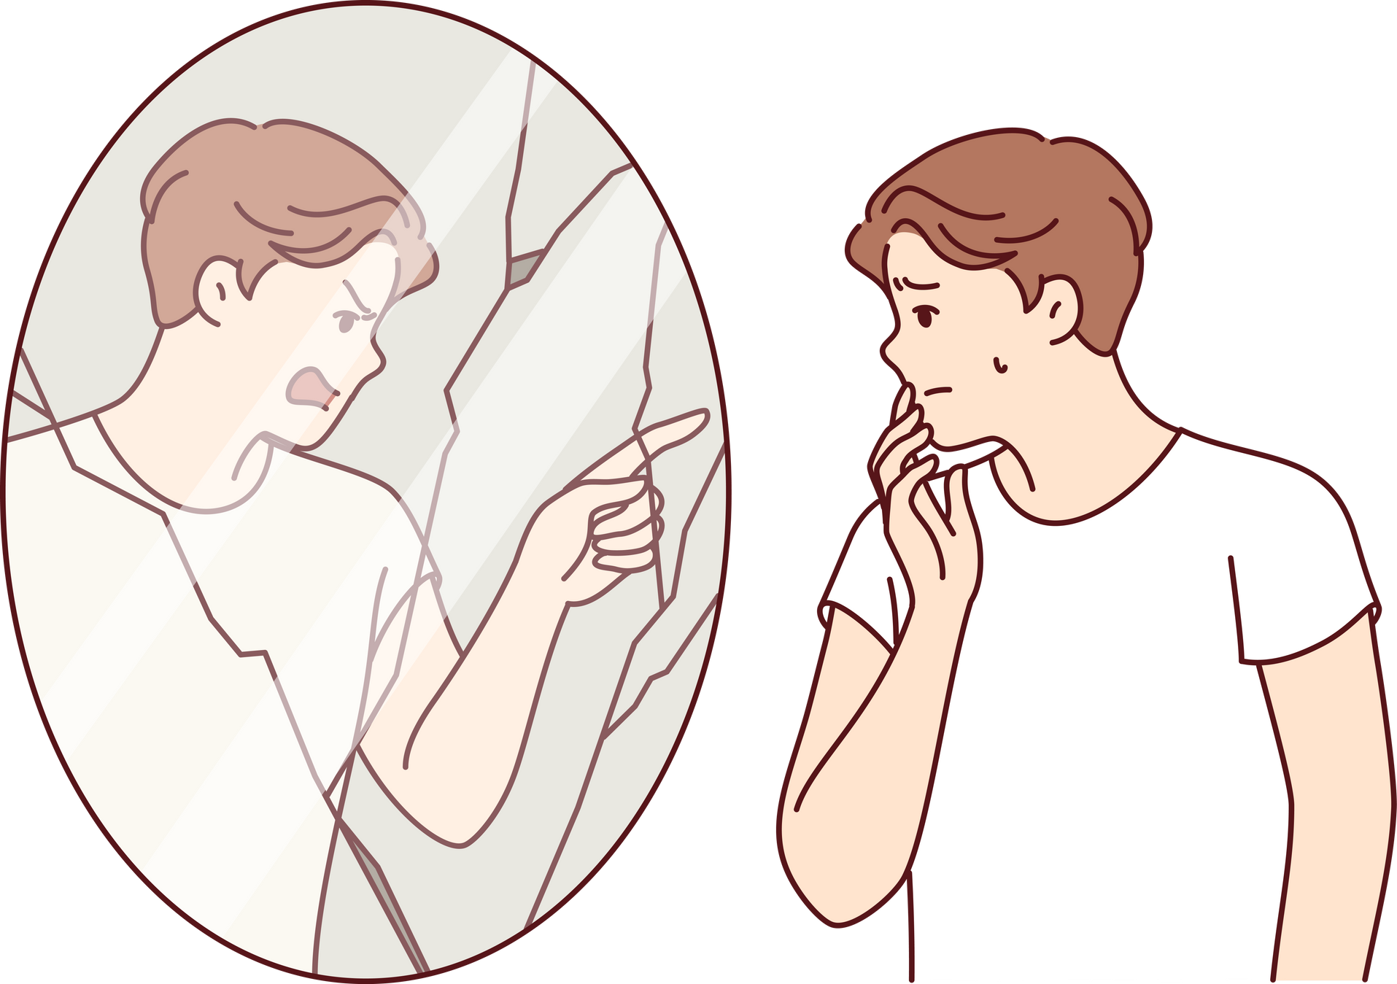
DIFFERENCE BETWEEN LOW SELF-ESTEEM AND HIGH SELF-ESTEEM

Slide 5
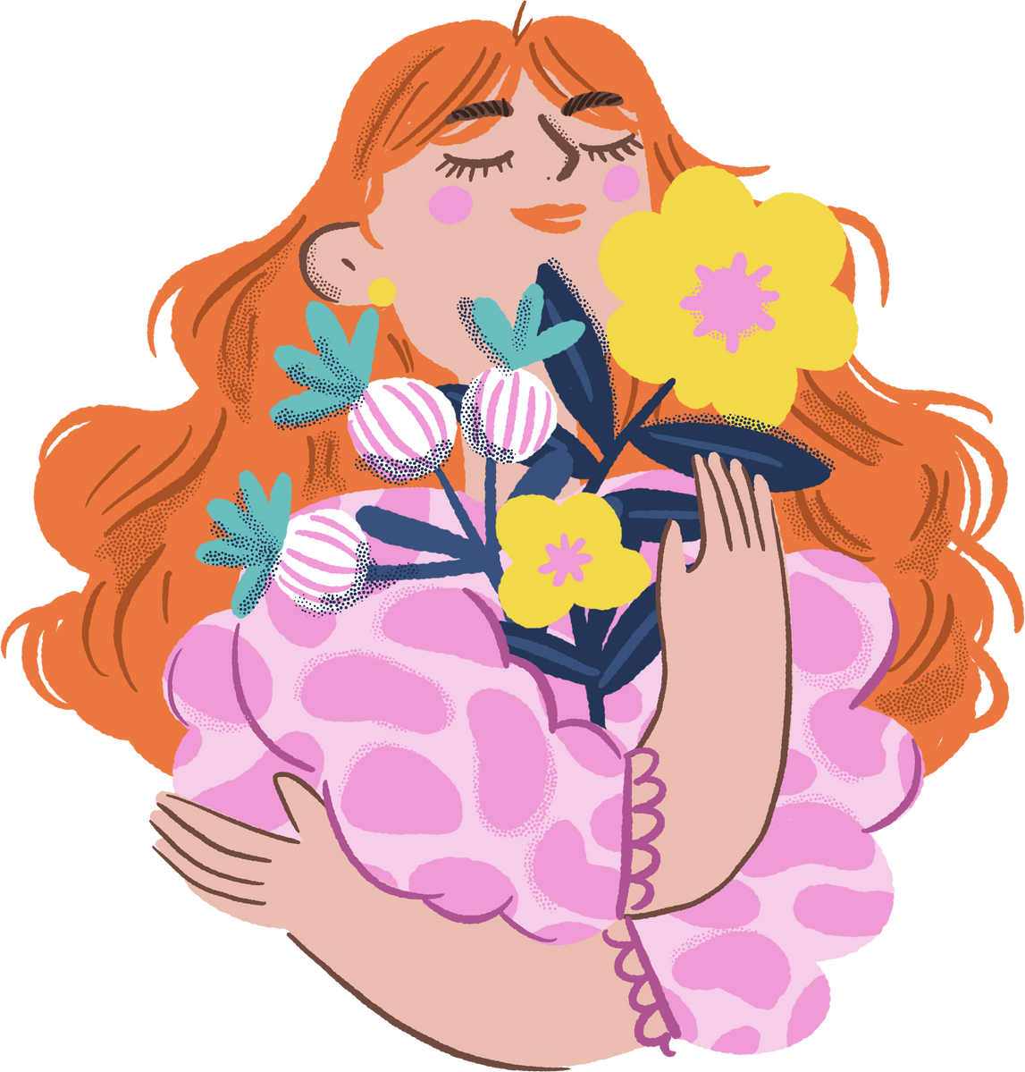
HIGH SELF-ESTEEM
Having high self-esteem means you have confidence in yourself and understand that you contribute positively to the world. You acknowledge that while you may have some flaws, your many strengths define who you are. You tend to view your circumstances as “half full.”

Slide 6
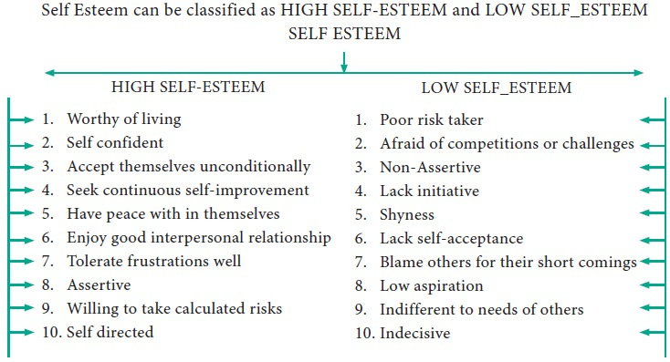
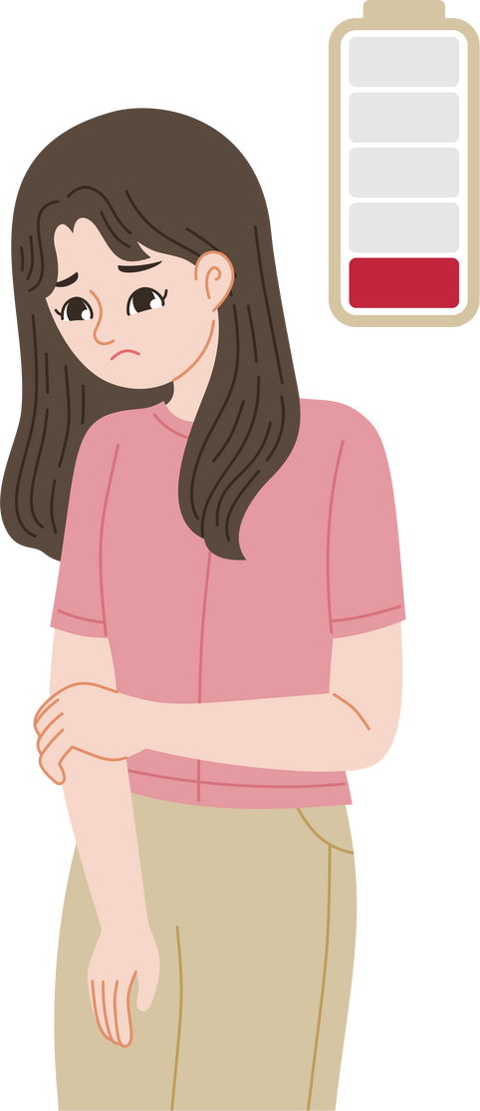
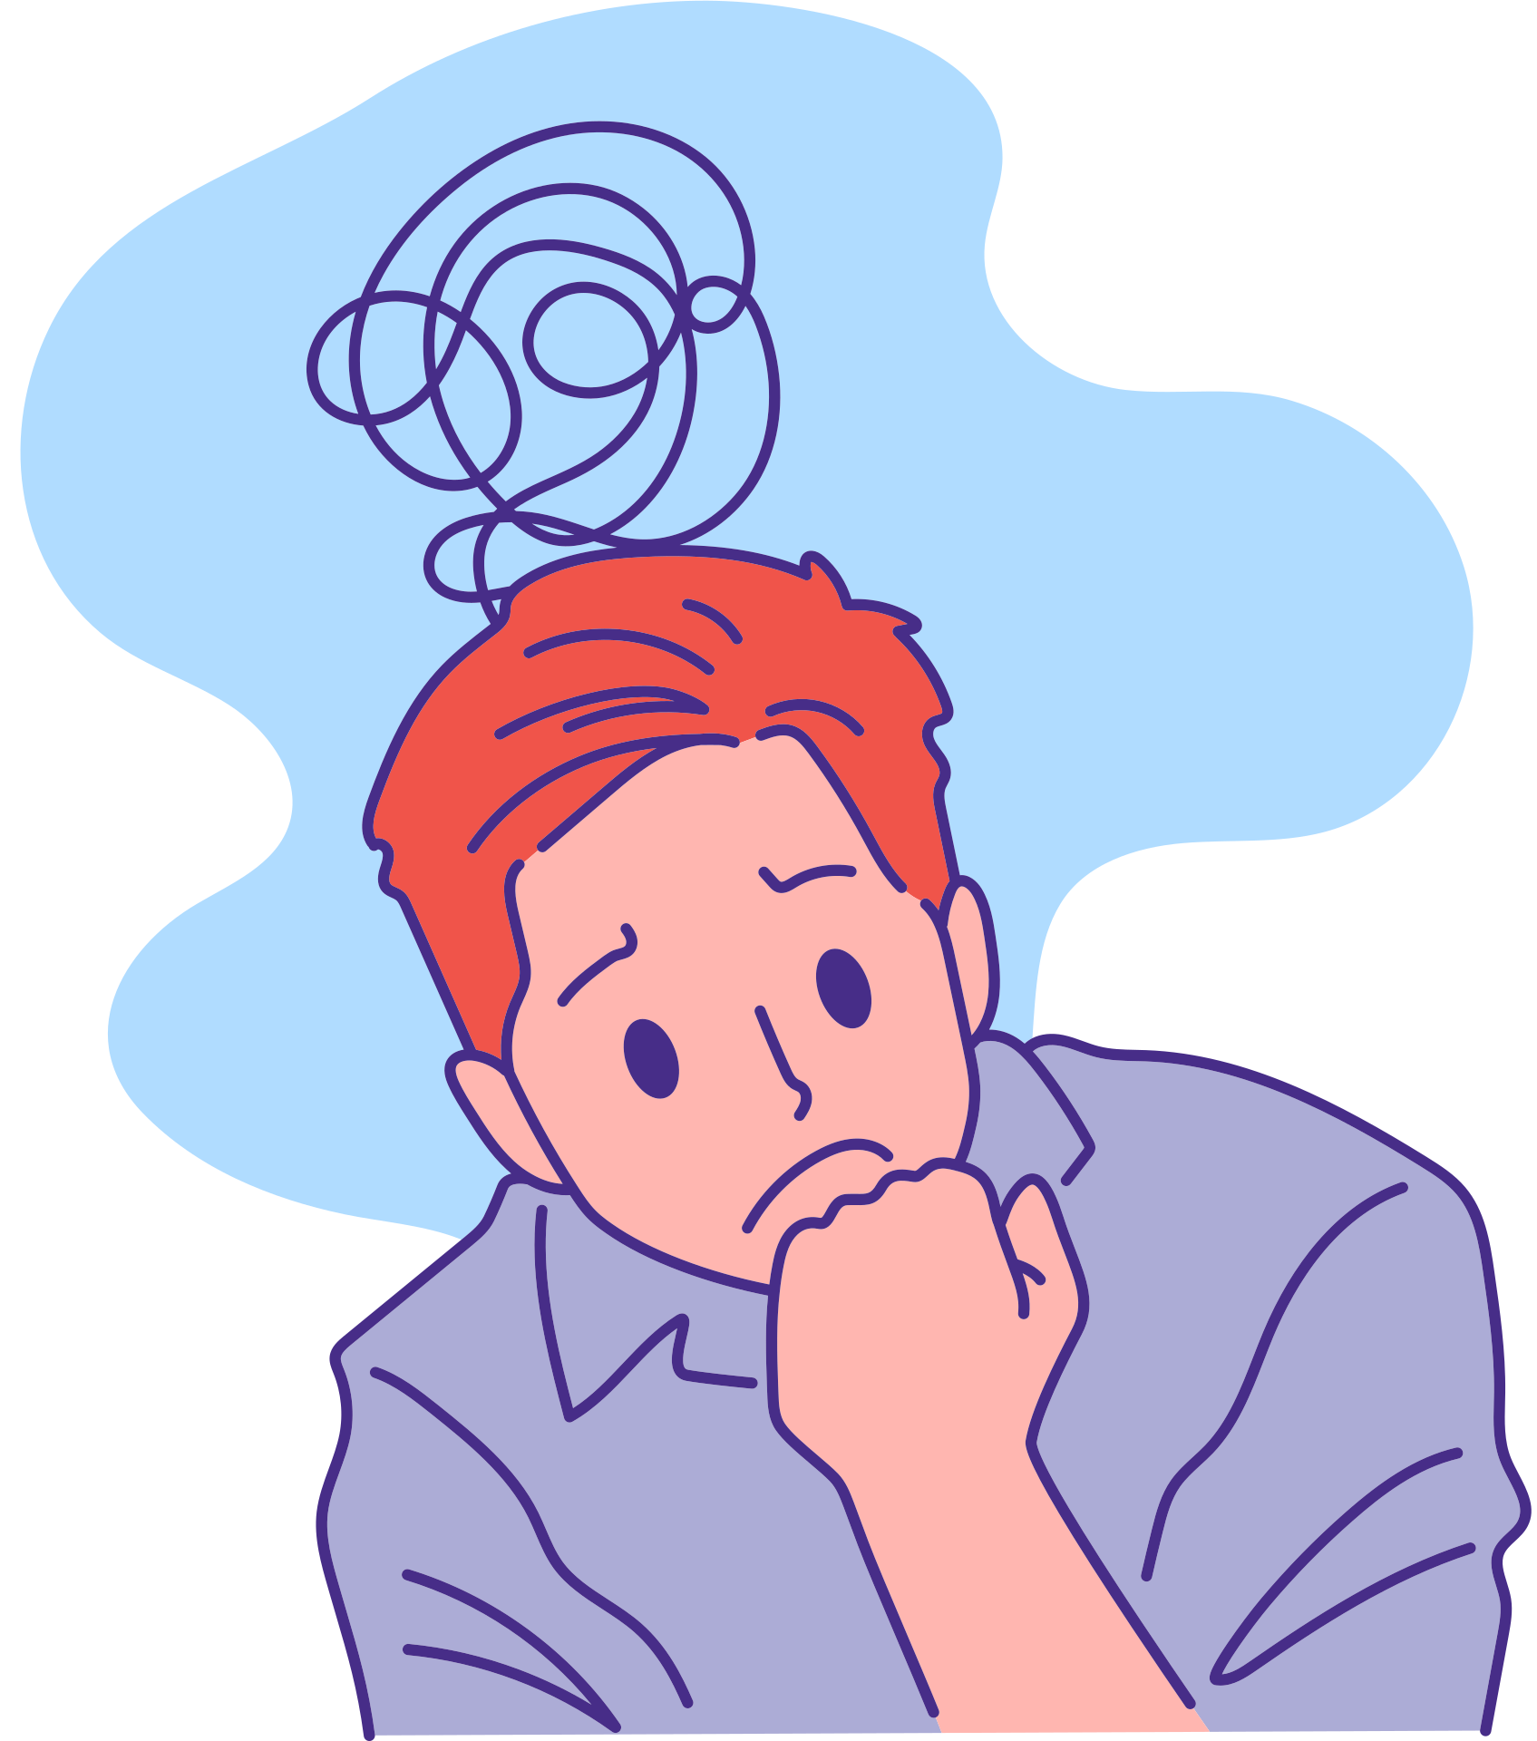

Slide 7
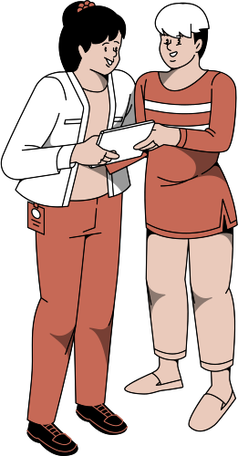
ADVANTAGES OF HIGH SELF-ESTEEM
Being Authentically Yourself
A person with high self-esteem is comfortable in their skin and knows they don’t need to change themselves in order to fit in.
.Having Good Communication Skills
When you feel confident about yourself, you’re more likely to express your thoughts clearly and listen to others well.
The Ability to Form Good, Healthy Relationships
High self-esteem helps you respect yourself and others, leading to stronger and more positive connections with people.

Slide 8
ADVANTAGES OF HIGH SELF-ESTEEM
Embracing New Challenges
With high self-esteem, you believe in your abilities, so you’re more willing to try new things without fear of failure.
Good Mental Health
Believing in yourself helps reduce stress and anxiety, leading to a more stable and positive mindset.

Slide 9

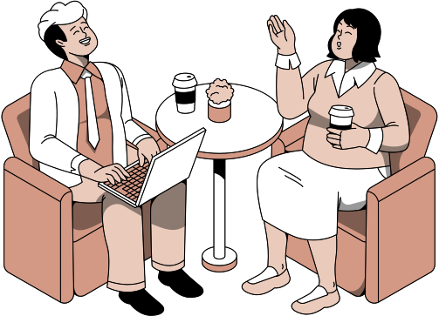
HOW TO INCREASE SELF-ESTEEM

Slide 10



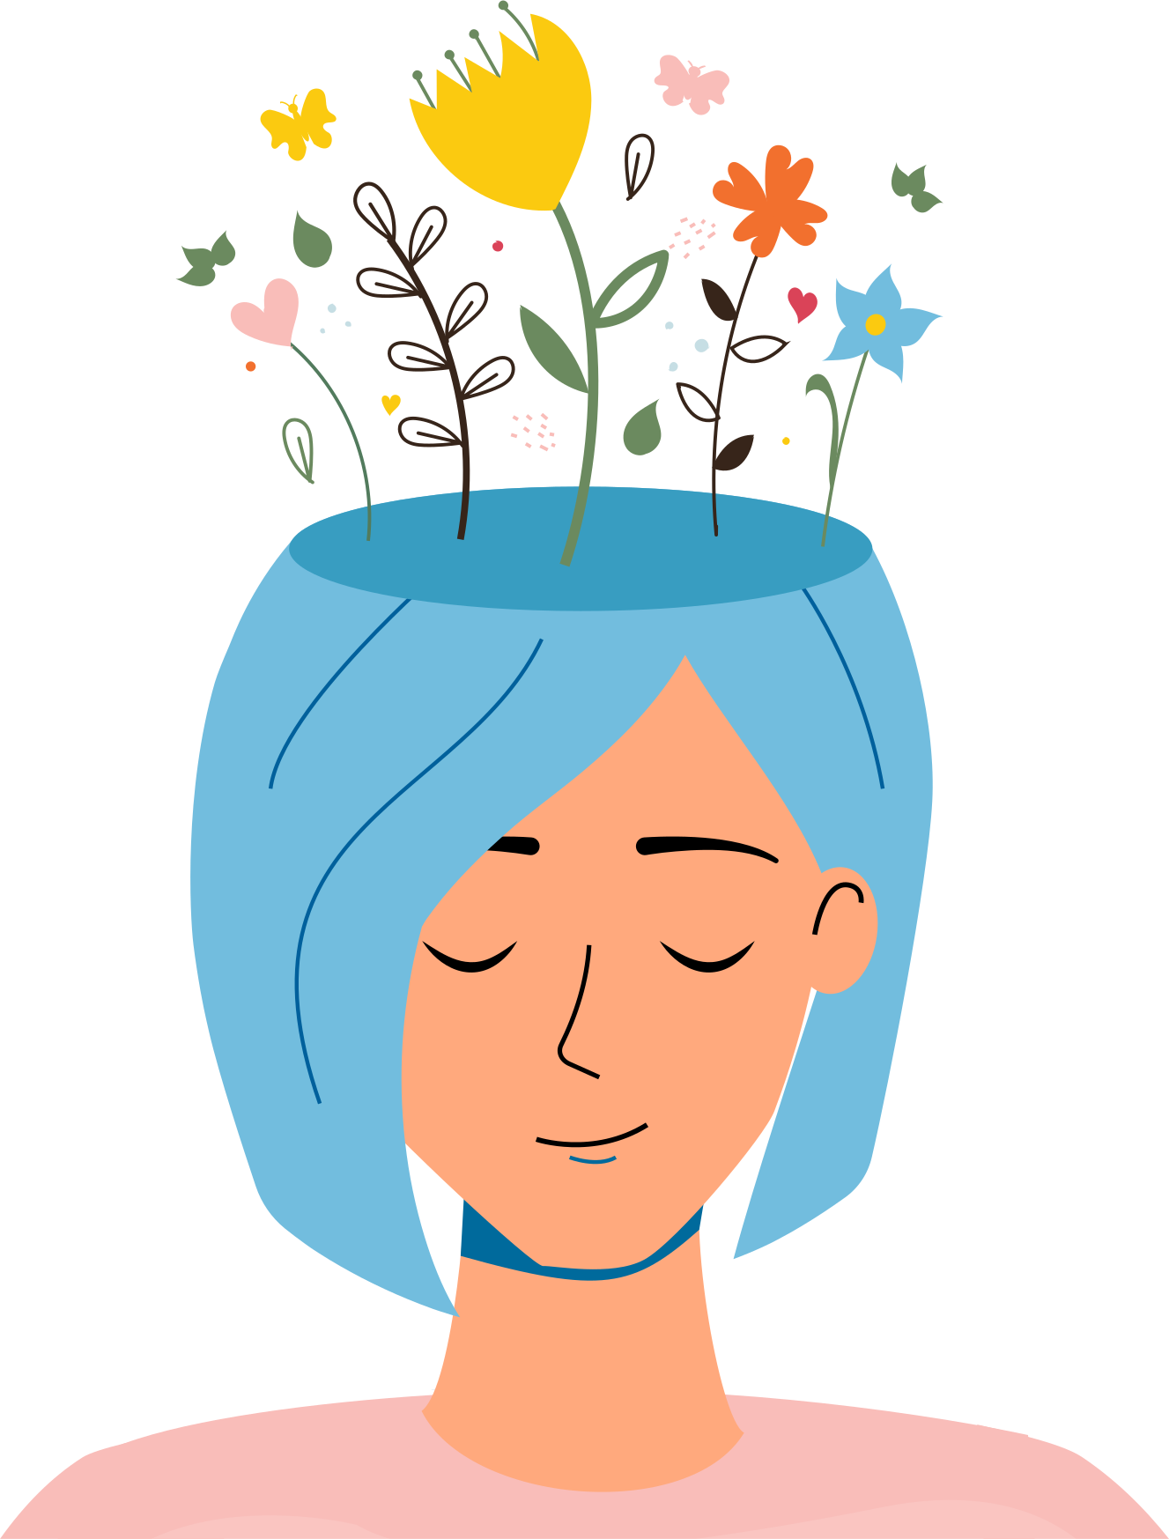
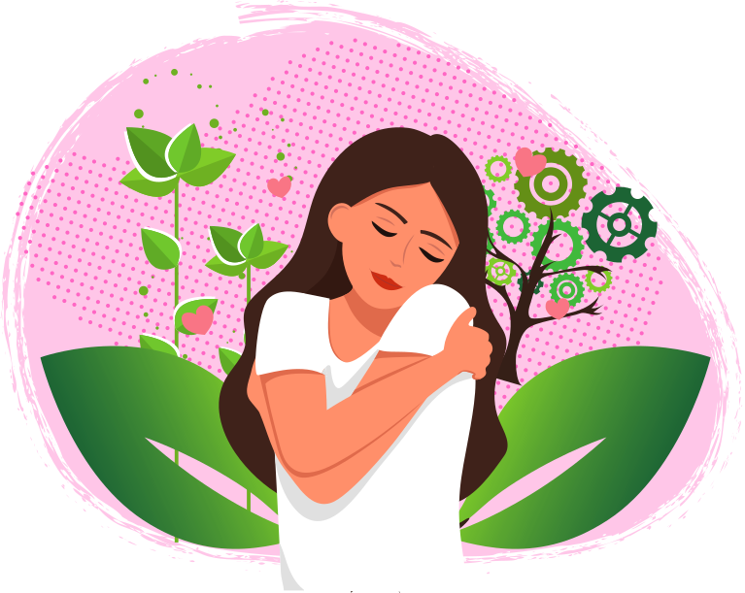

Be kind to yourself
Try to recognize positives:
-Get to know yourself.
-Try to challenge unkind thoughts about yourself
-Say positive things to yourself.
-Practice saying no.
-Try to avoid comparing yourself to others.
-Do something nice for yourself.
-Celebrate your successes.
-Accept compliments.
-Ask people what they like about you
-Write a list of things you like about yourself

Slide 11
Build a support network:
Set yourself a challenge:
-Talk to someone you trust.
-Focus on positive relationships.
-Try peer support
-Try volunteering.
-Set small goals.
-Learn something new.

Slide 12


Look after yourself:
-Try to get enough sleep.
-Think about your diet.
-Try to do some physical activity.
-Spend time outside.
-Practice mindfulness and meditation.
-Try to avoid recreational drugs and alcohol.

Slide 13
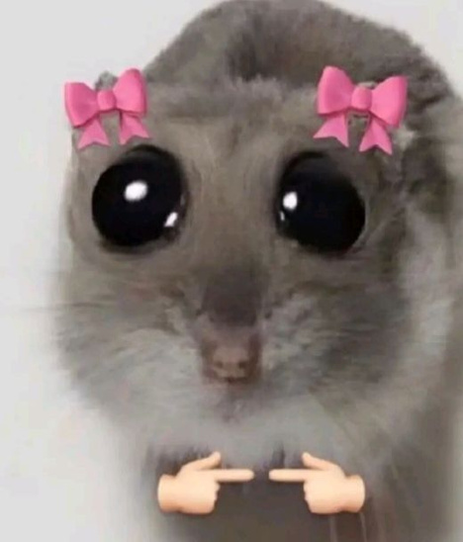
BRING OUT 1/4 PAPER
we’re having a quiz mate, i hope you listen.
we’re having a quiz mate, i hope you listen.

Slide 14
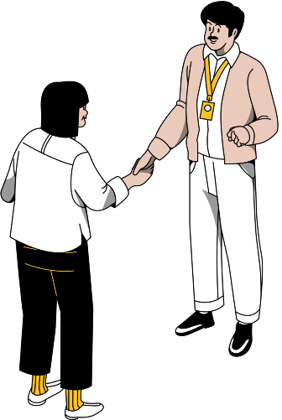
THANK YOU

